Slide 1
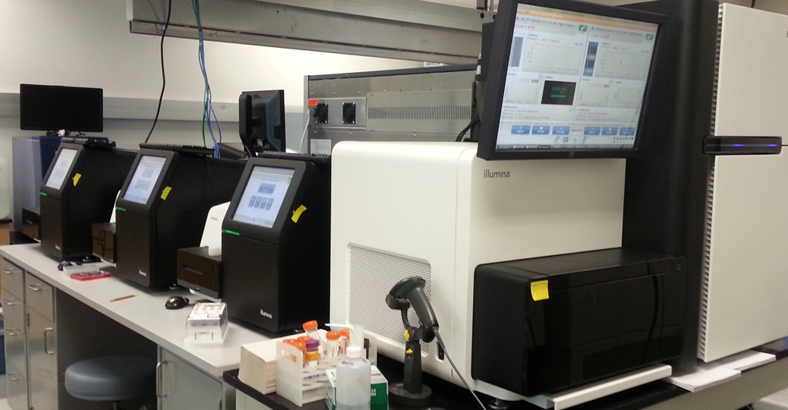

Human Chromosomes. Credit: Jane Ades, NHGRI
The Genome Assembly Workshop
Lutz Froenicke
DNA Technologies & Expression Analysis Cores
UC Davis Genome Center
2020

Slide 2
DNA Technologies & Expression Analysis Cores
HT Sequencing Illumina
Long-Read & Linked Read Sequencing PacBio, Oxoford Nanopore, 10X Genomics
HMW DNA isolation
Illumina microarray (genotyping)
Consultations → Experimental Design (Bioinformatics Core & DNA Tech Core)
introducing new technologies to the campus
shared equipment
teaching (workshops)

Slide 3
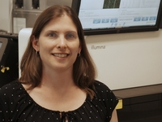
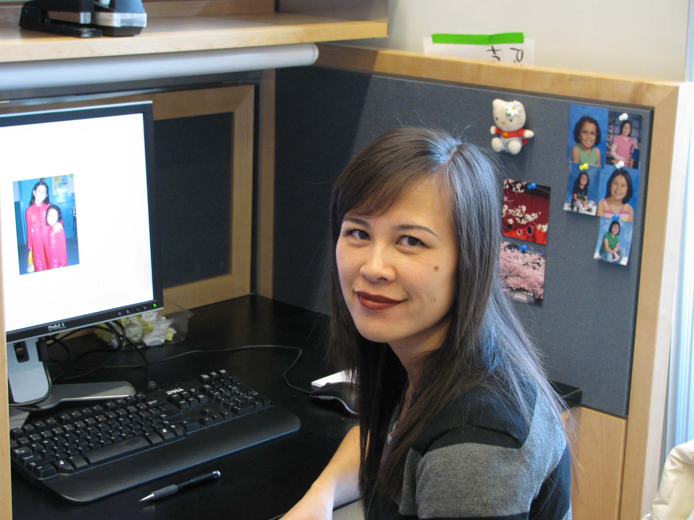
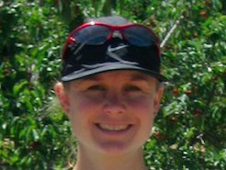
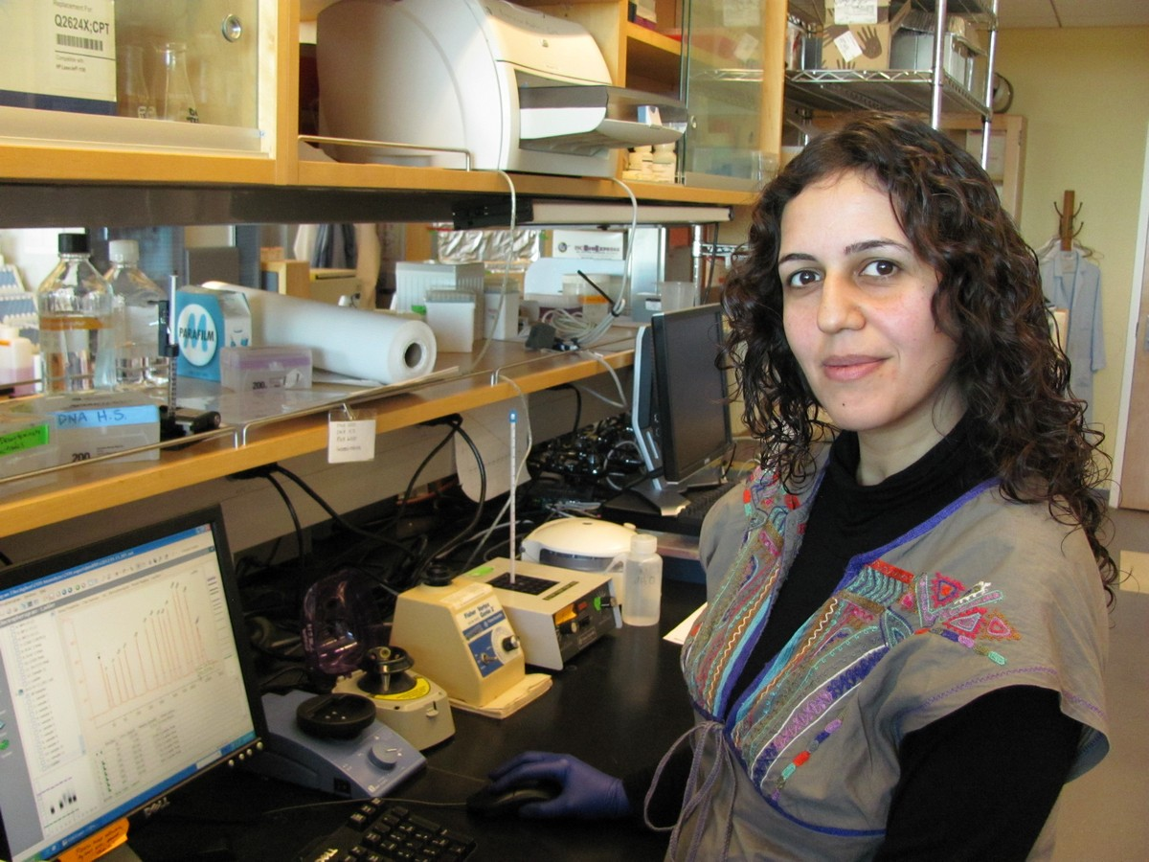
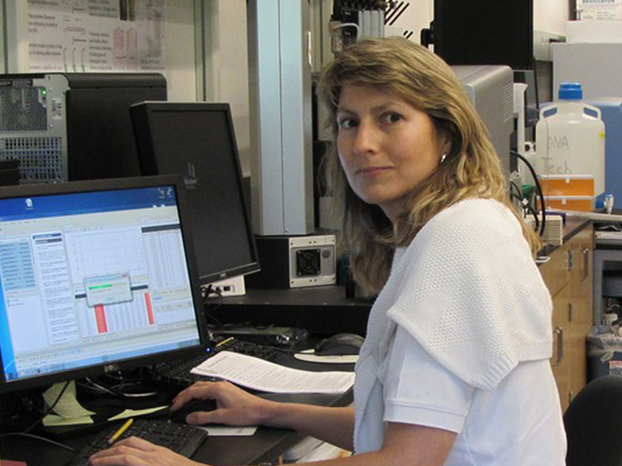
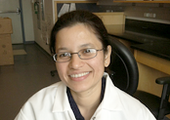
The DNA Tech Core Team
Emily
Oanh
Diana
Siranoosh
Vanessa
Ruta

Slide 4
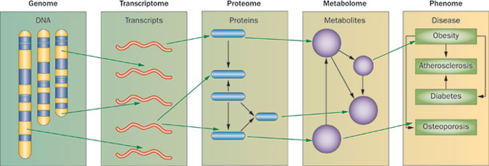

The UCD GENOME CENTER
DNA Tech & Expression Analysis
Proteomics Core
Metabolomics Core
“DNA makes RNA and RNA makes protein“
the Central Dogma of Molecular Biology; simplified from Francis Crick 1958
MacLellan, W. R. et al. (2012) Systems-based approaches to cardiovascular disease
Nat. Rev. Cardiol. doi:10.1038/nrcardio.2011.208

Slide 5
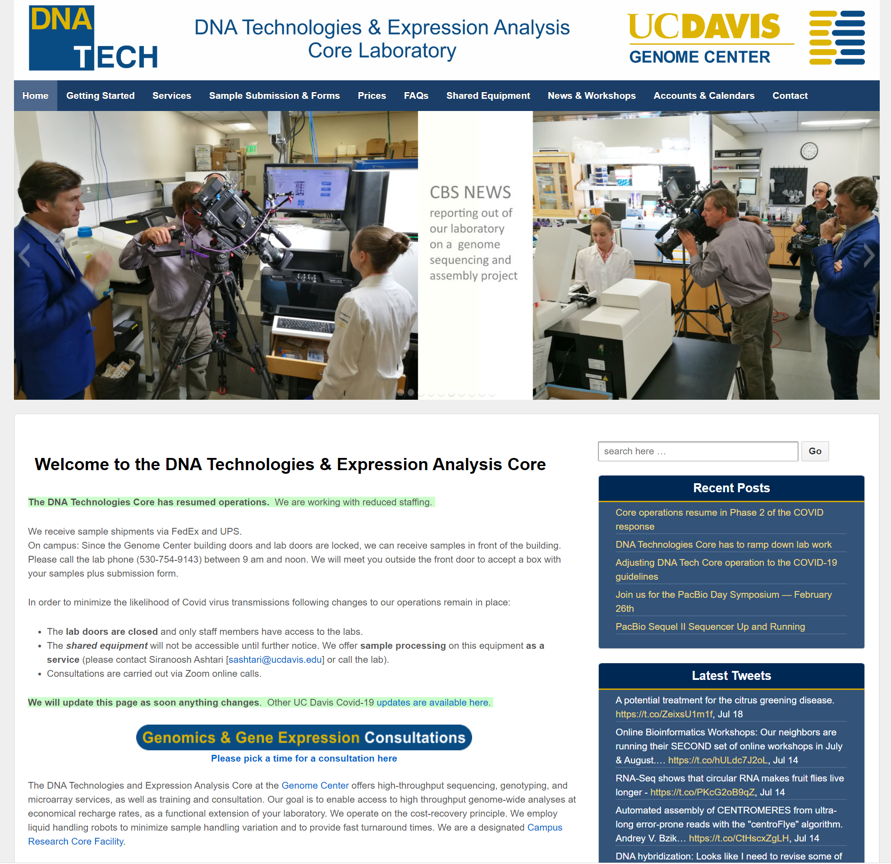

Slide 6
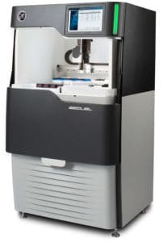
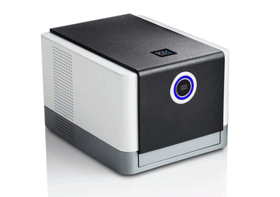
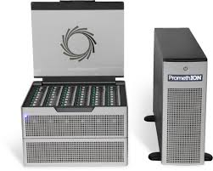
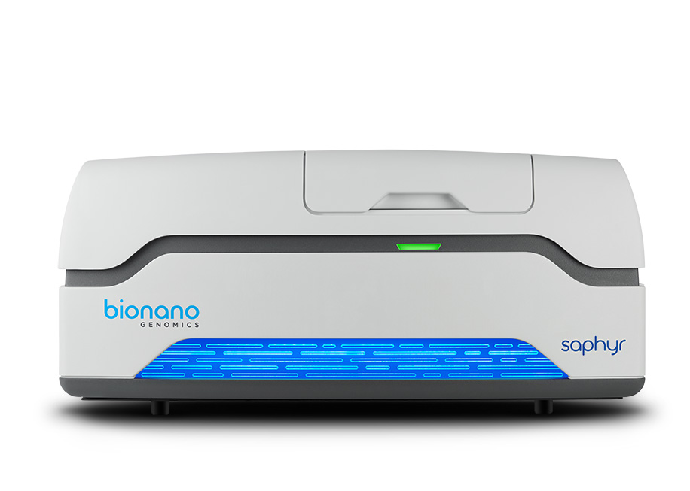
DNA Tech Genome Assembly Tools
10X Genomics Chromium Genome “linked-reads”
PacBio Sequel II “super-long reads” >20kb
PacBio Sequel “high-fidelity-long reads” (Q20,Q30, 15kb & 20kb)
PromethION Nanopore “super-long reads” >20kb
MinION Nanopore “ultra-long reads” >100 kb
Bionano Optical Genome Mapping (scaffolding) > 150 kb
Hi-C (chromosome scale genome scaffolding)

Slide 7
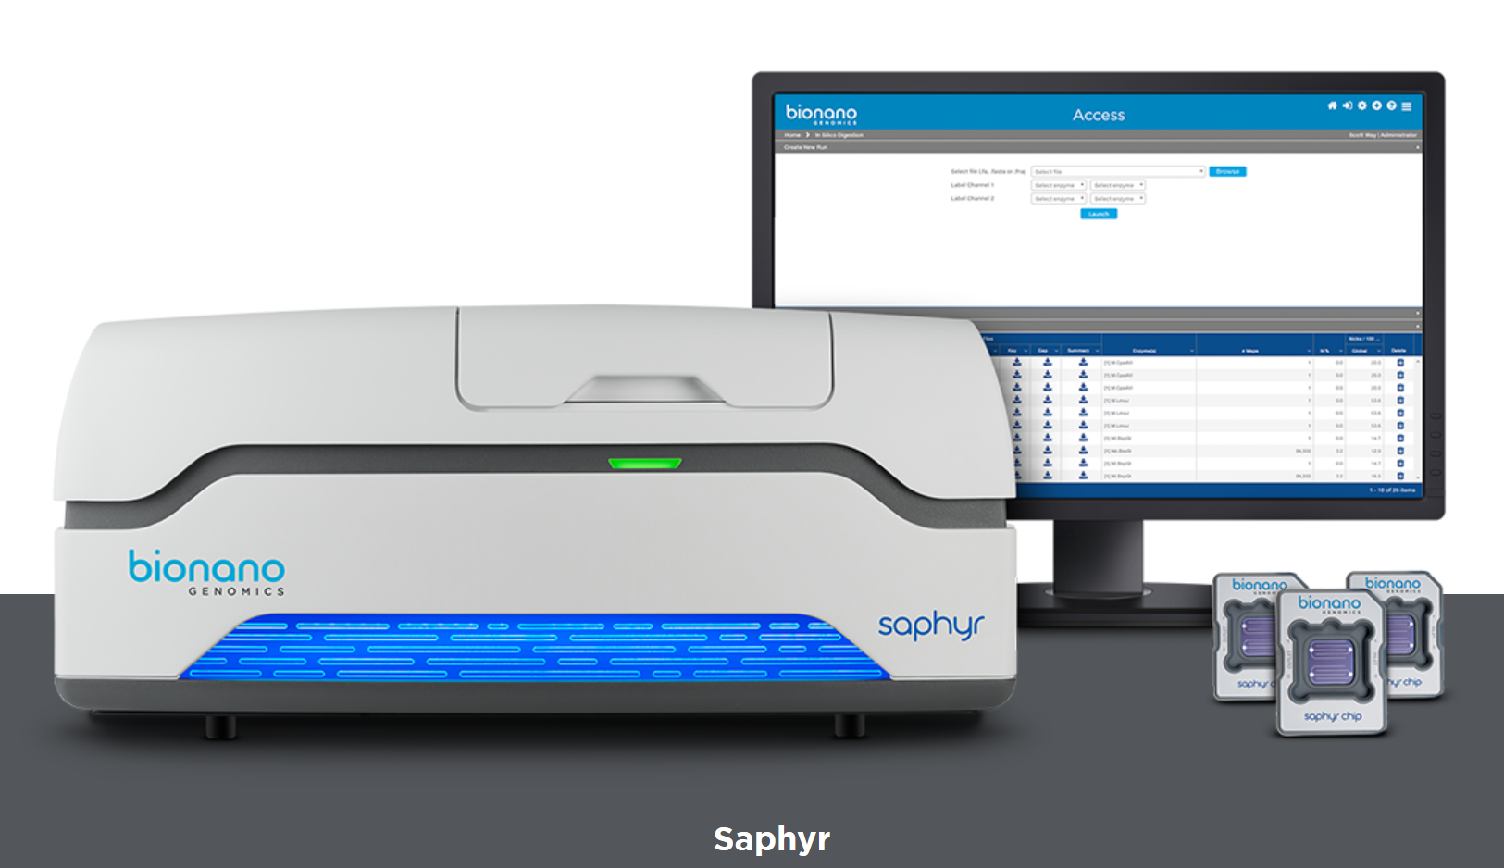
Bionano Saphyr Optical Genome Mapping

Slide 8


Slide 9
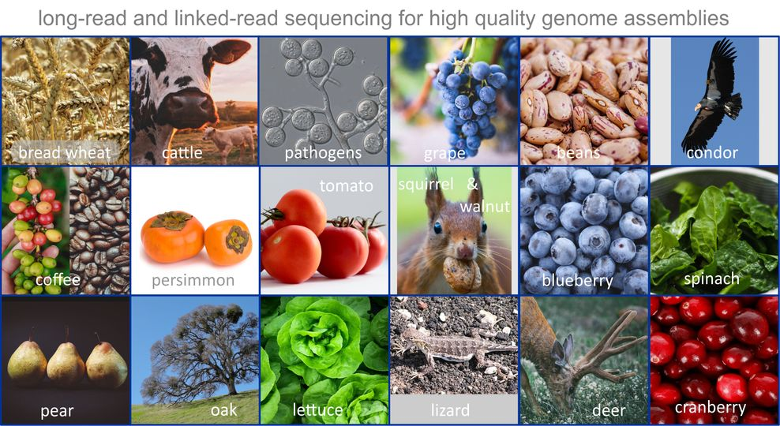
Experience 200+ species/varieties with PacBio 140+ species with 10x Genomics as of December 2019

Slide 10
DNA Quality !!!
HMW DNA isolation
Physical damage (PFGE image is not fully informative)
Chemical damage
Chemical contamination
Sample specific protocols?
Nuclei isolation, agarose plugs
Cell culture?
Rescue efforts (BluePippin; DNA damage repair) tend to have minimal impact

Slide 11
Input DNA requirements for gDNA sequencing
Good quality, high molecular weigh DNA >50Kb in length
Free of contaminants such as polysaccharides, proteins, salts, etc
Nanodrop ratio of 260/280=1.8 260/230=2.0

Slide 12
DNA isolation protocol
Liquid nitrogen grinding + sorbitol pre-wash + CTAB buffer lysis + Sodium acetate and isopropanol precipitation ( Inglis et al)
Pippin pulse gel image
Femto trace

Slide 13
PromethION run results
ONT library prep protocol: 50Kb shear + SRE, LSK109 library prep
Name | Total yield | Read length N50 | Bases >100Kb and Q7 (% of total data) | Bases >200Kb and Q7 (% of total data)
Ninja | 81Gb | 36Kb | 0.4Gb (0.4%) | 0.6Mb(0.0007%)
US96UC23 | 52Gb | 36Kb | 0.3Gb (0.6%) | 0.6Mb(0.001%)
Pi251246 | 94Gb | 37Kb | 0.6Gb (0.6%) | 4.6Mb (0.04%)
Ar Seriola | 98Gb | 37Kb | 0.8Gb (0.8%) | 7.1Mb(0.007%)
Salinas | 93Gb | 27Kb | 0.1Gb (0.19%) | 0.4Mb (0.0004%)
Longest read ~200Kb range

Slide 14
Complementary Approaches
Illumina | PacBio CLR | PacBio HiFi | PromethION Nanopore
Still-imaging of clusters (~1000 clonal molecules) | Video recordings fluorescence of single molecules | Video recordings fluorescence of single molecules | Recording of electric current through pores
Short reads - 2x300 bp Miseq | Up to 70 kb, N50 25 kb | Up to 20 kb, N50 18 | Up to 100 kb, N50 30 kb
Repeats are mostly not analyzable | spans retro elements | accurate enough to assemble through REs | spans retro elements
High output - up to 2.4 Tb per lane | up to 100 Gb per SMRT-cell | up to 25 Gb HiFi data per cell | Up to 100 Gb per flowcell
High accuracy ( < 0.5 %) | Raw data error rate 15 % | CCS data < 0.1% | Raw data error rate 8 %
Considerable base composition bias | No base composition bias | No base composition bias, but still mononucleotide repeat problem | Some systematic errors,
Very affordable | Costs 3 to 5 times higher | Costs 3 to 5 times higher | Costs 2x higher
De novo assemblies of thousands of scaffolds | “Near perfect” genome assemblies | “Near perfect” genome assemblies; lowest error rate | “Near perfect” genome assemblies with suppl. data; highest contiguity

Slide 15
Strengths and weaknesses (diploid genomes)
 | 10X/TELL-Seq | Sequel CLR | Sequel HiFi | PromethION
Accuracy –single read | 4 | 1 | 4 | 2
Accuracy - consensus | 4 | 4 | 4 | 3
Contiguity | 1-2 ? | 3-4 | 3 | 4
Yield/$ | 4 | 4 | 2 | 4
In many case the resulting assembly quality will depend on the DNA sample quality as well genome organization (repeat content/length).
Pacbio relative even performance ( fish ?; jellyfish?)
Nanopore: significant variance between organisms Plants ++; birds -, fish -, jellyfish -

Slide 16
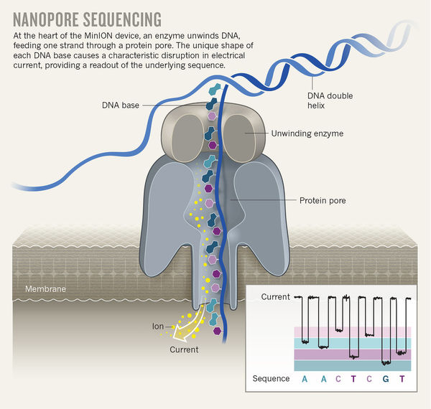
How does nanopore sequencing work ?
Raw data fast5
Basecaller
RNN, flip-flop
Guppy 3.2.8
fastq
ATCG
Huge data size

Slide 17
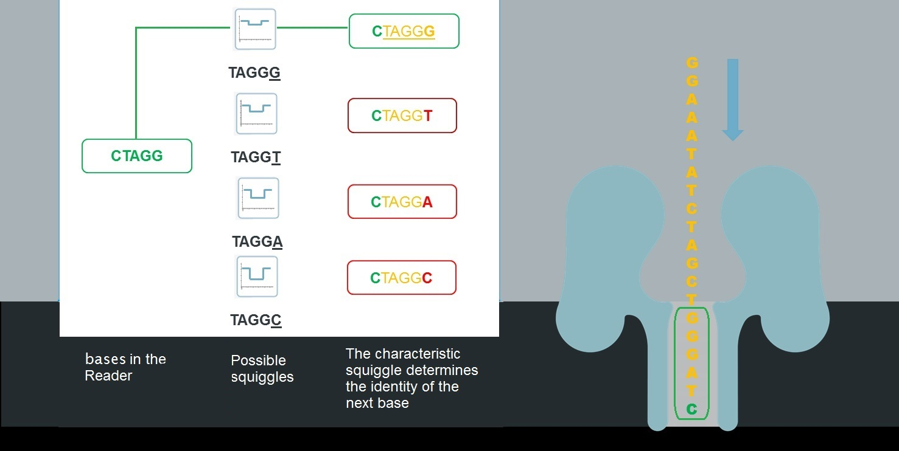
non-random errors

Slide 18
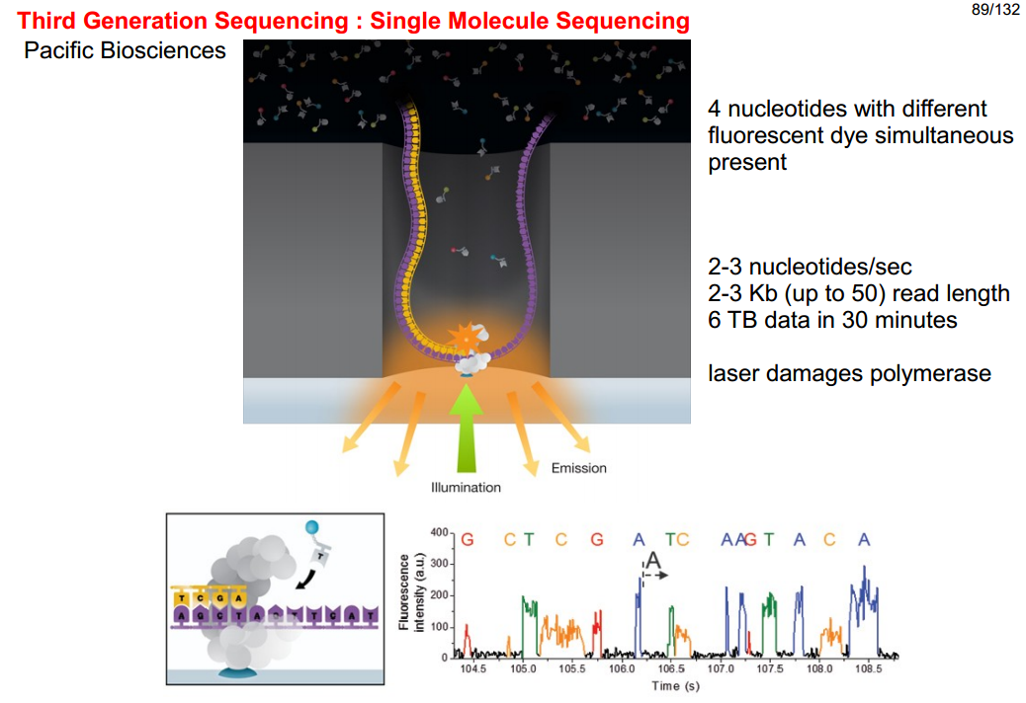
70 nm aperture
“Zero Mode Waveguide”

Slide 19
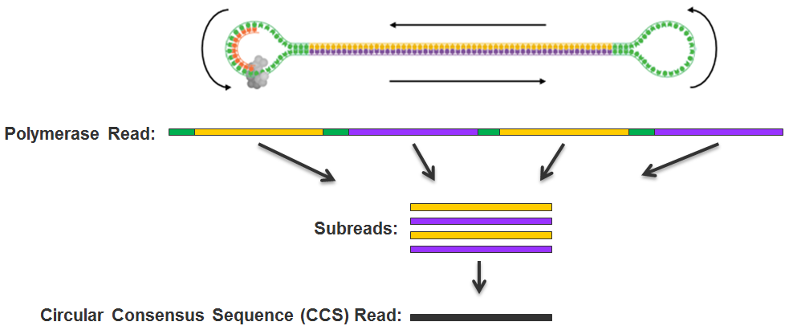
SMRT-bell adapters circular sequencing
Source: PacBio

Slide 20
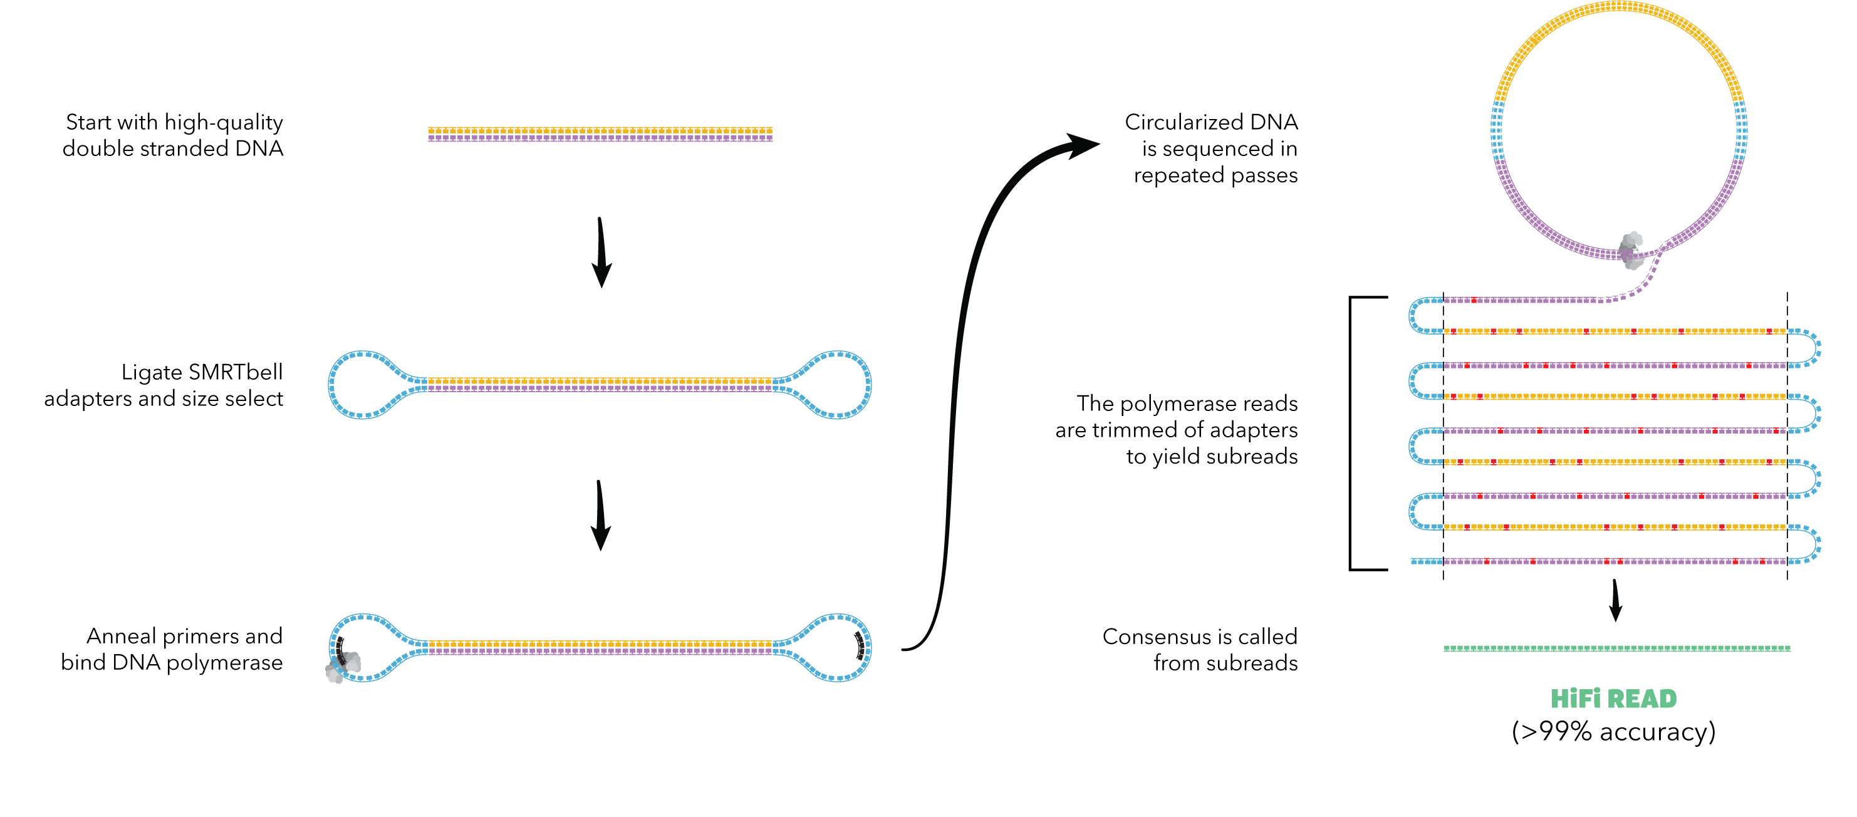

Slide 21
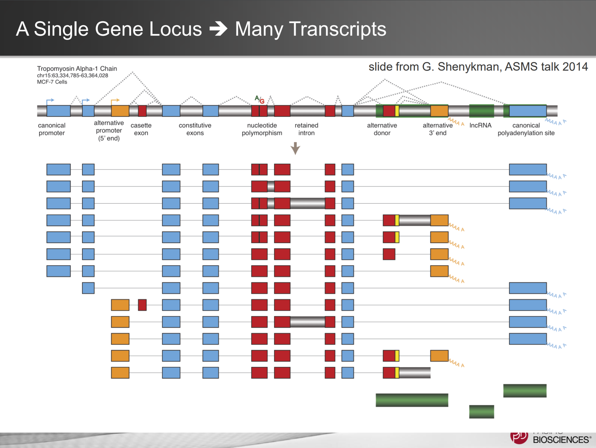

Slide 22
Iso-Seq Pacbio
Sequence full length transcripts → no assembly; default for gene annotation
High accuracy
More than 95% of genes show alternate splicing
On average more than 5 isoforms/gene
Precise delineation of transcript isoforms (PCR artifacts? chimeras?)

Slide 23
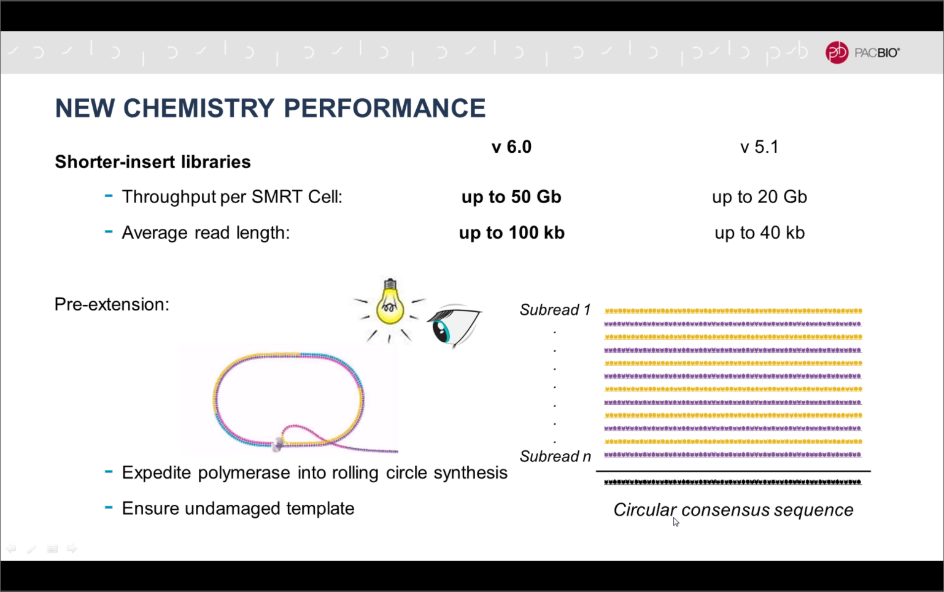
Source: PacBio

Slide 24
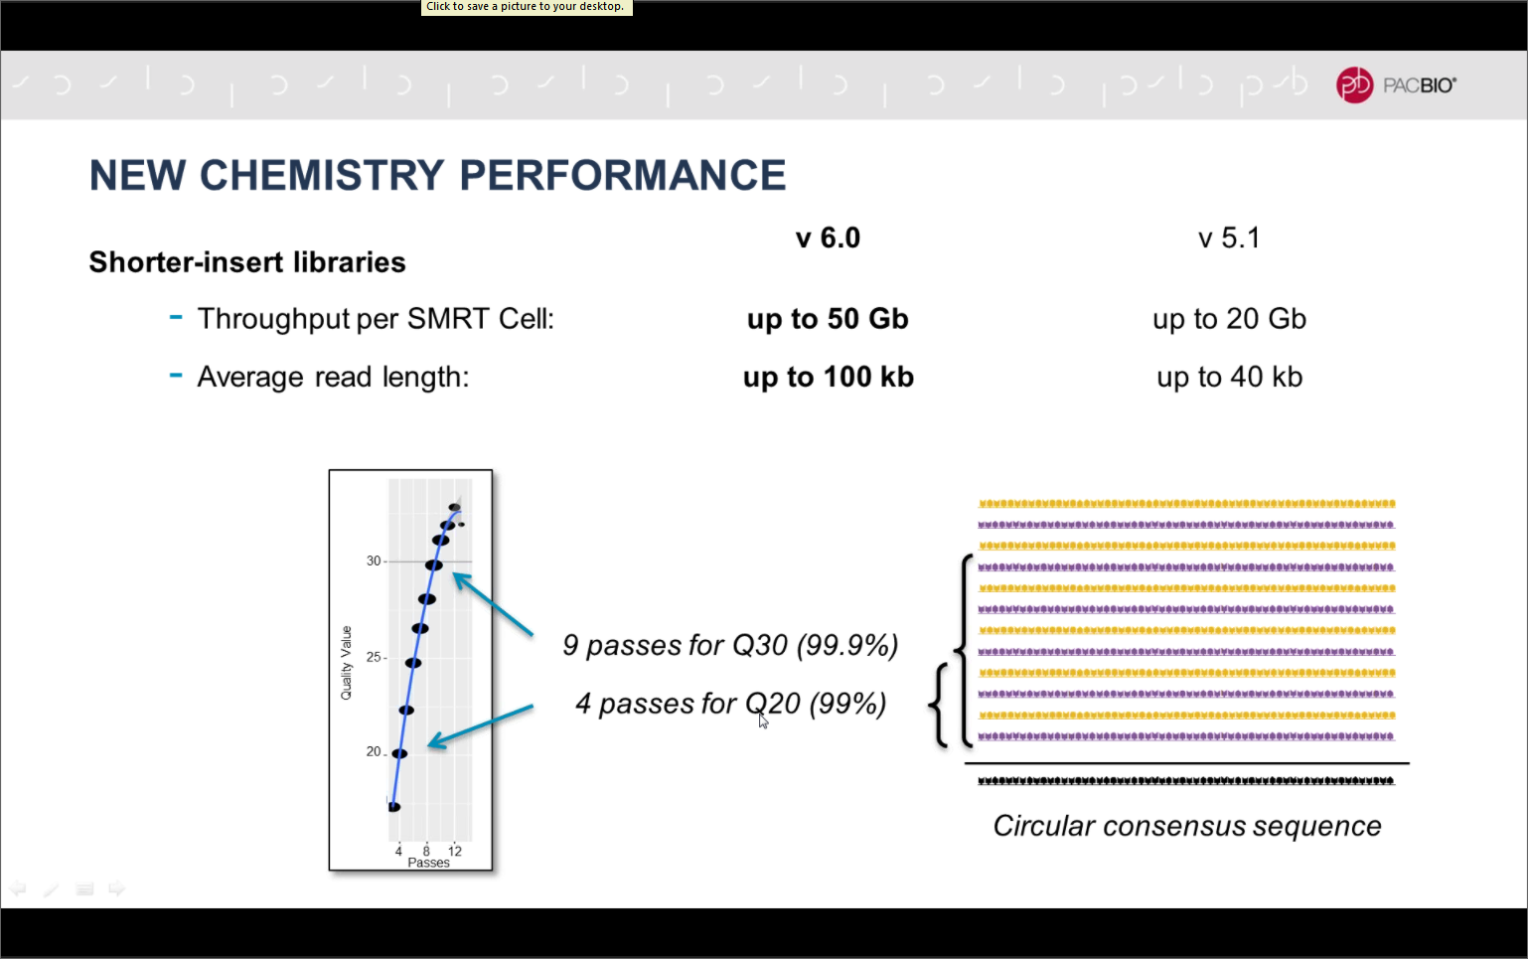
Source: PacBio

Slide 25
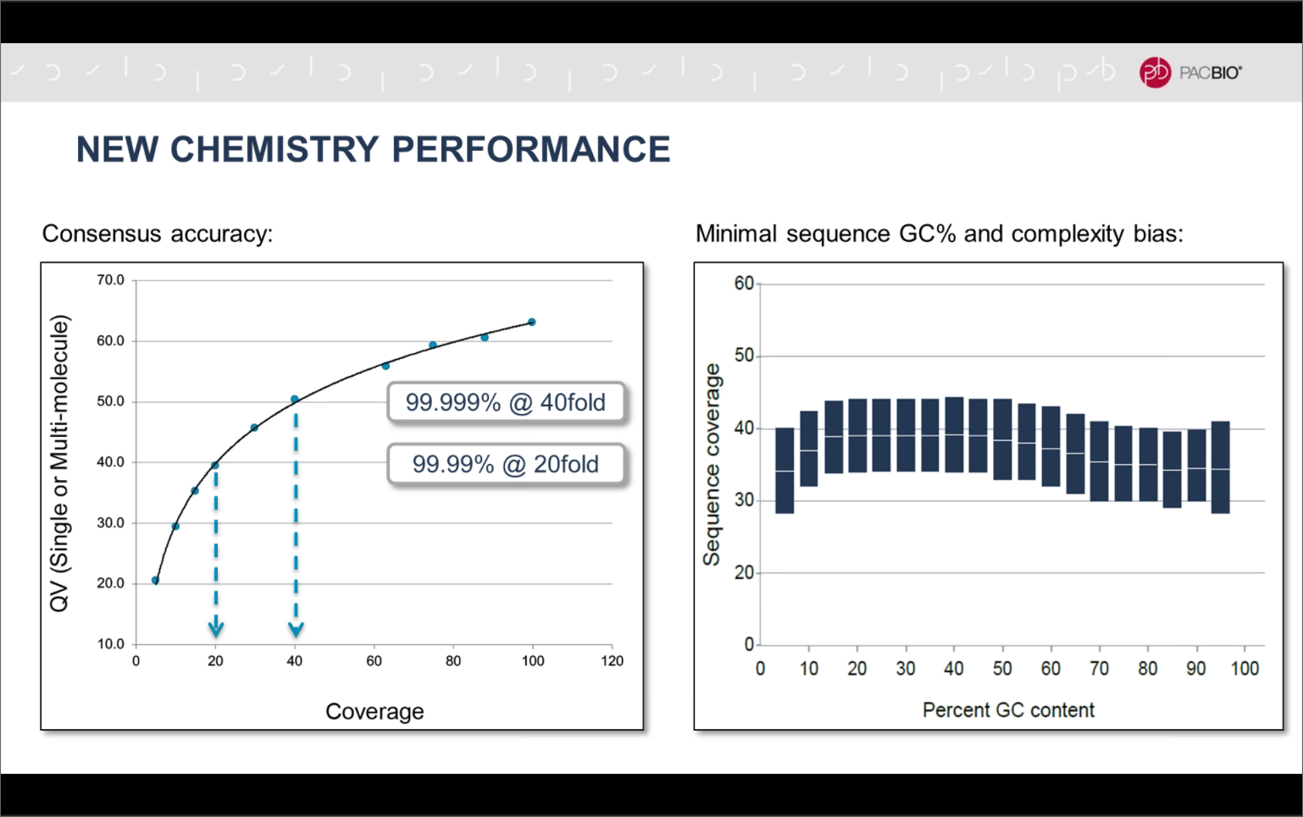
Source: PacBio

Slide 26


Slide 27
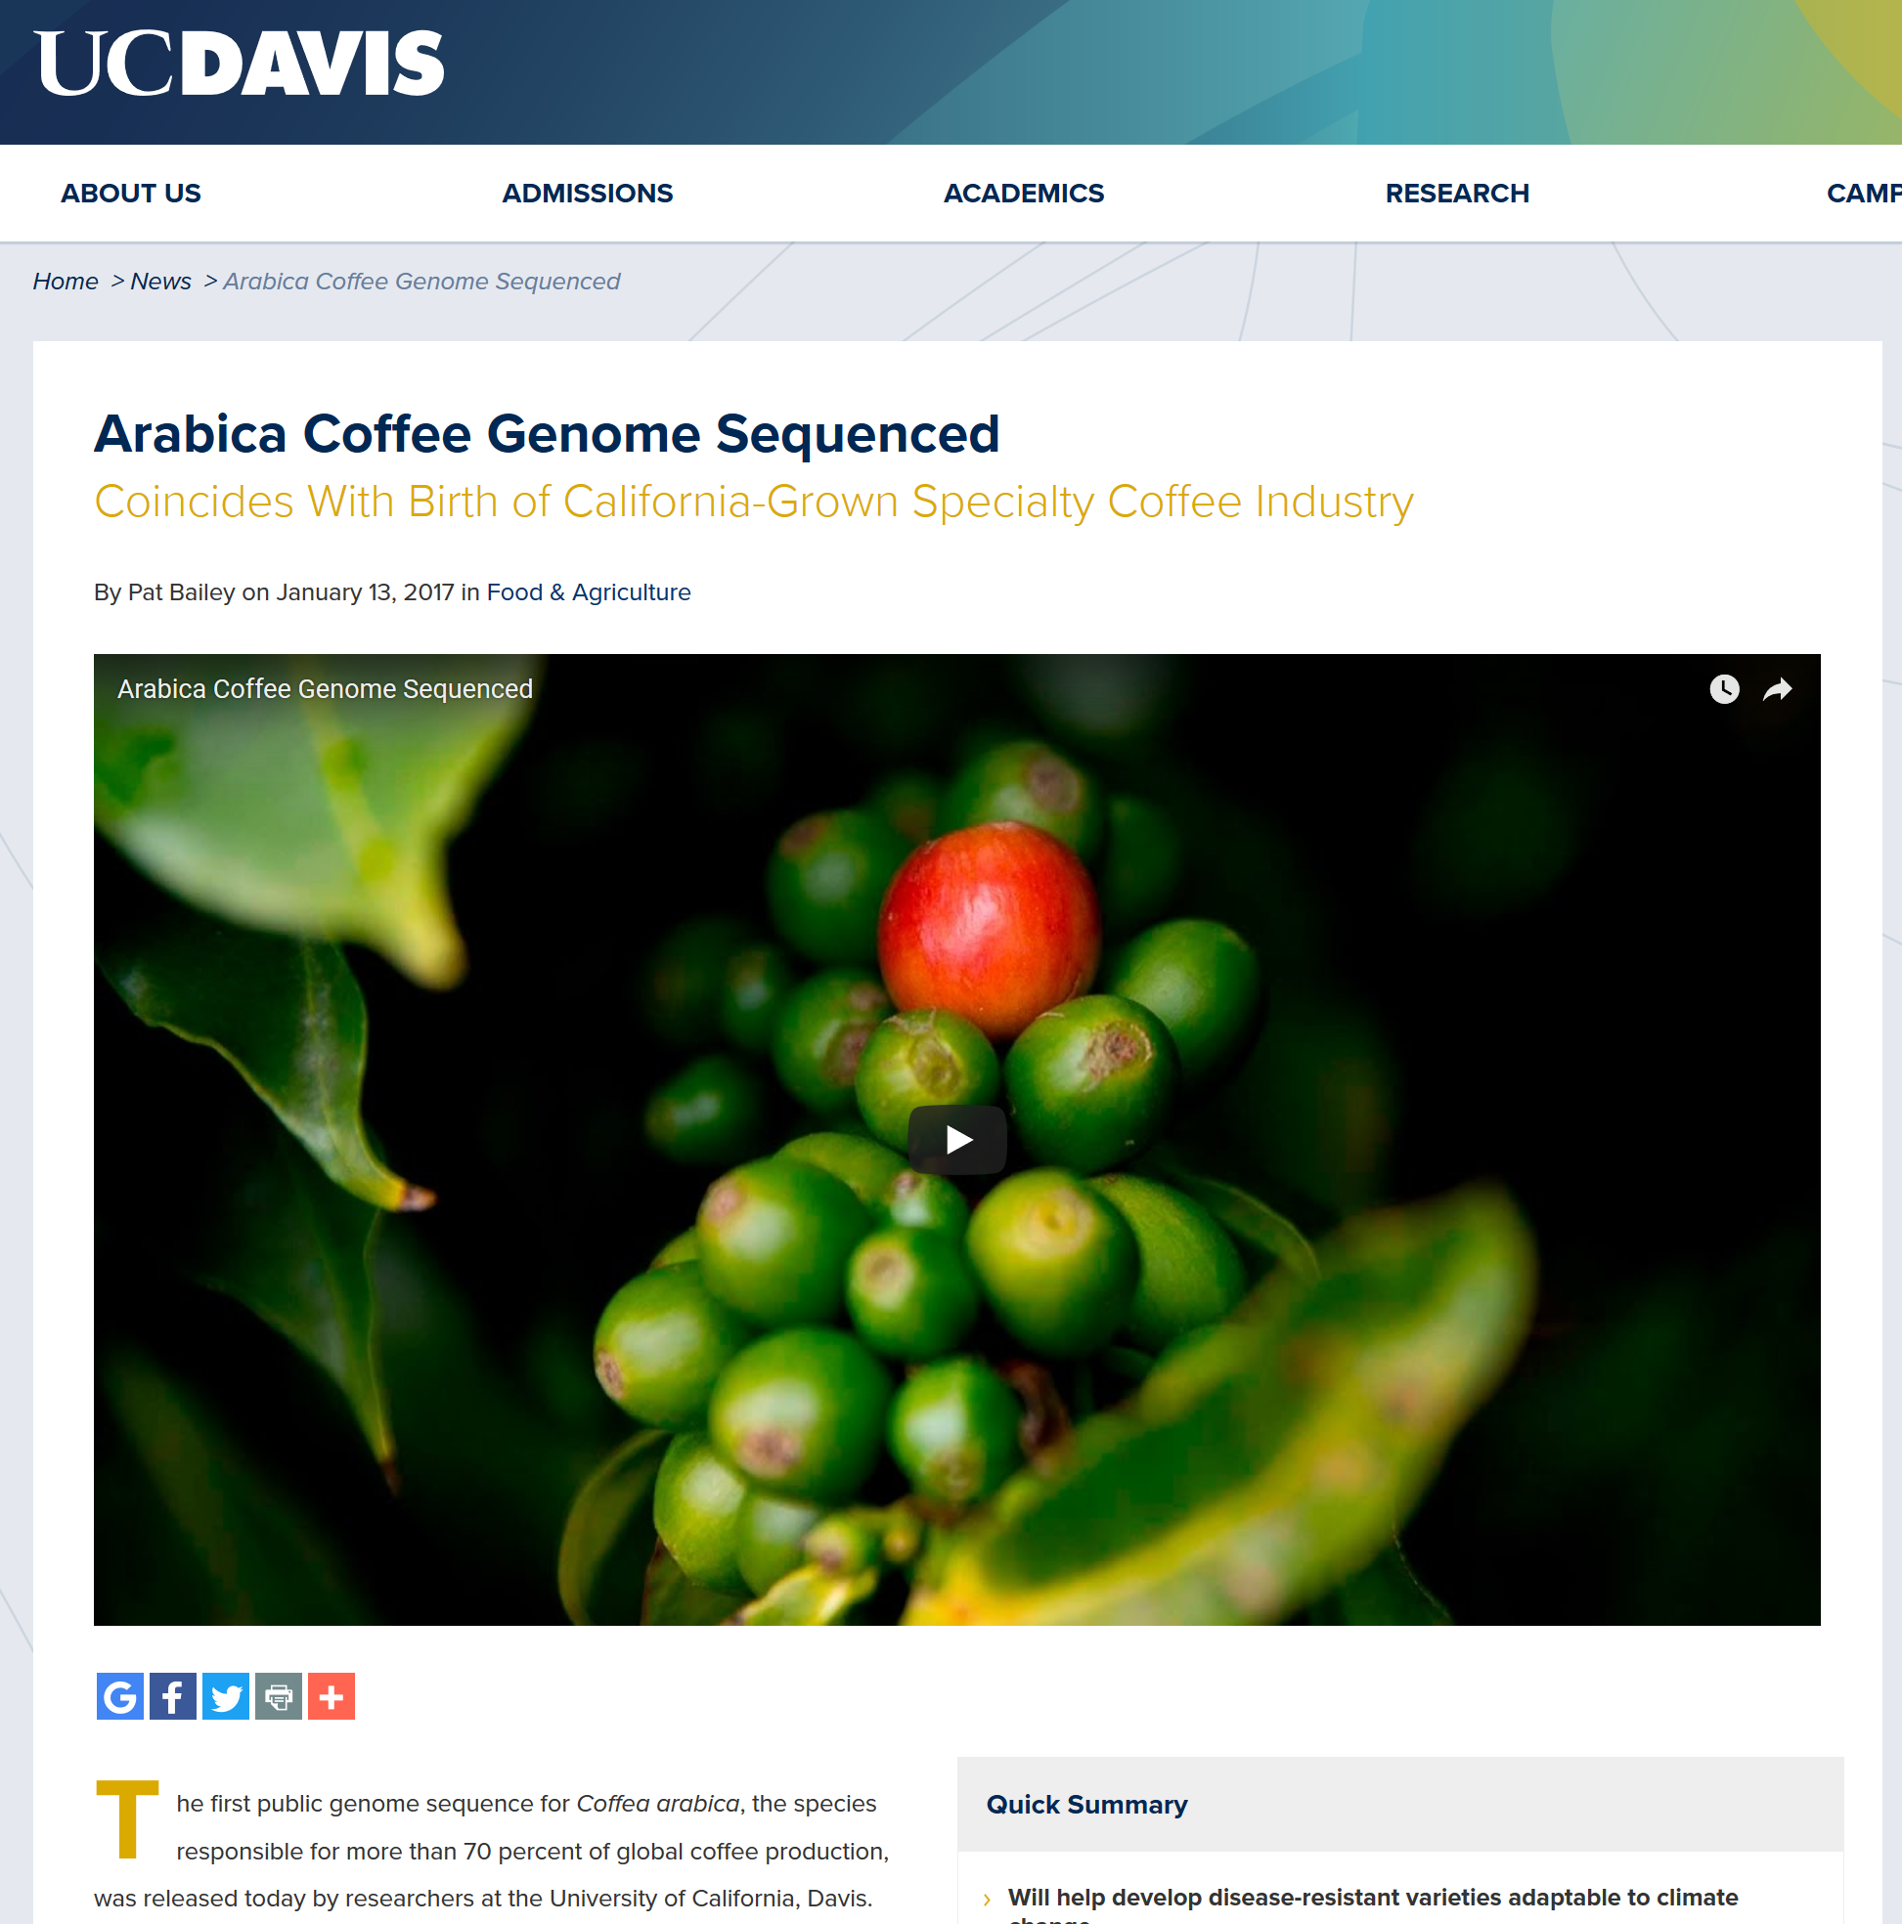
Coffee 2017: arabica 1.3 Gb genome Medrano et al. PacBio & ChICAGO scaffolding Scaffold N50 = 2.24 Mb Contig N50= 1.31 Mb 2015: robusta 0.7 Gb

Slide 28
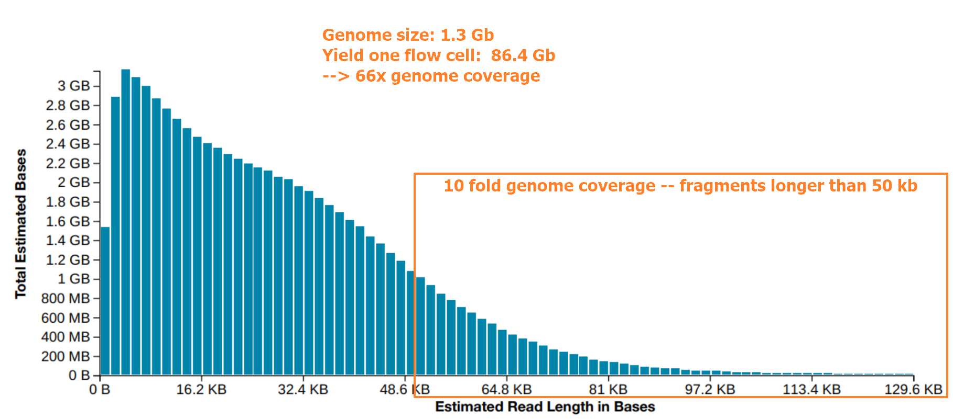
PromethION read lengths
RL histogram arabica

Slide 29
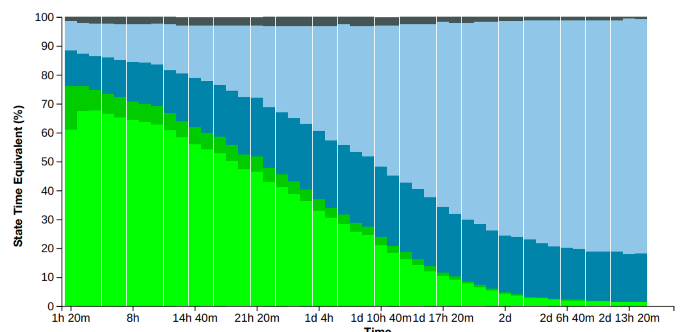
Yield over time

Slide 30
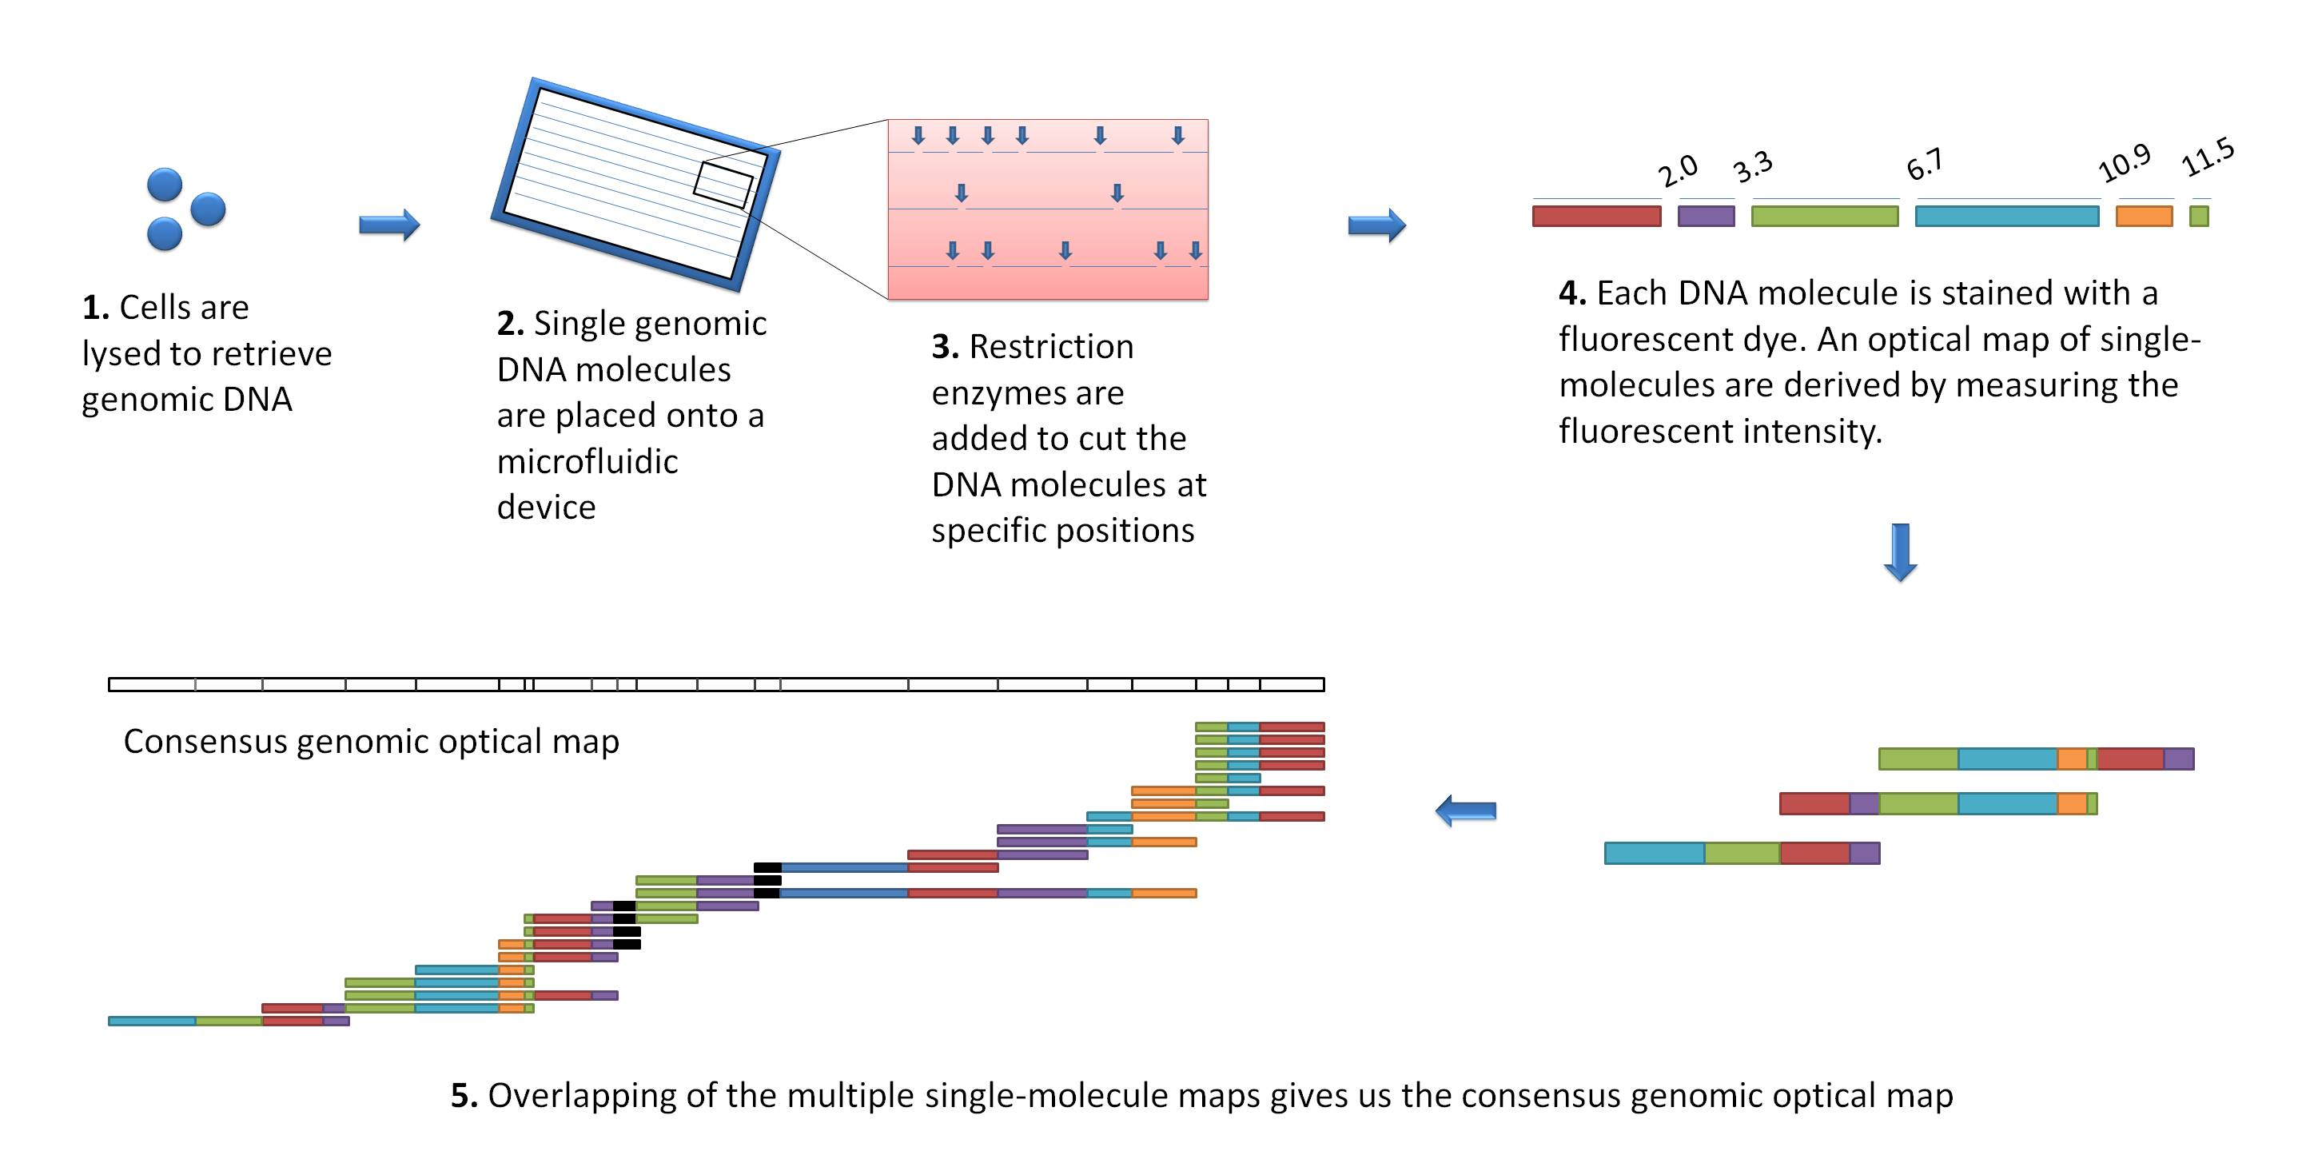
Bionano Optical Genome Mapping
Contig N50 of assembly > 40 kb
In silico digests

Slide 31
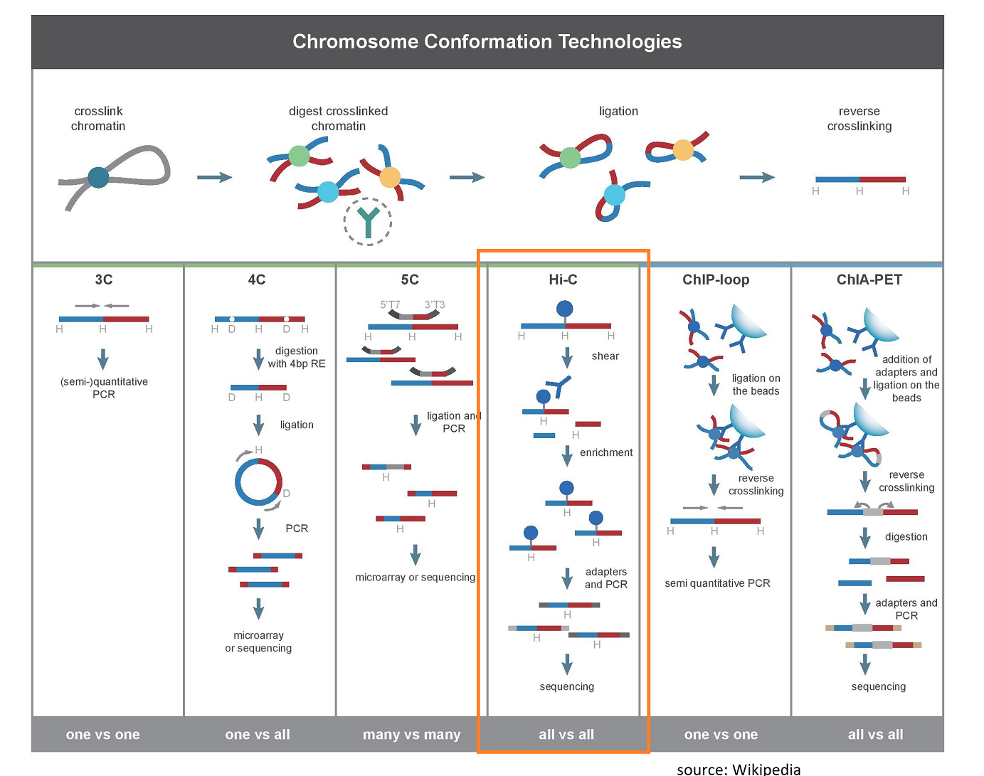
Hi-C chromosome-scale scaffolding

Slide 32

Future’s so bright

Slide 33
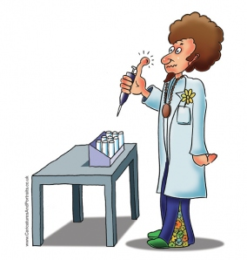
Thank you!
Let’s get started!

Slide 34
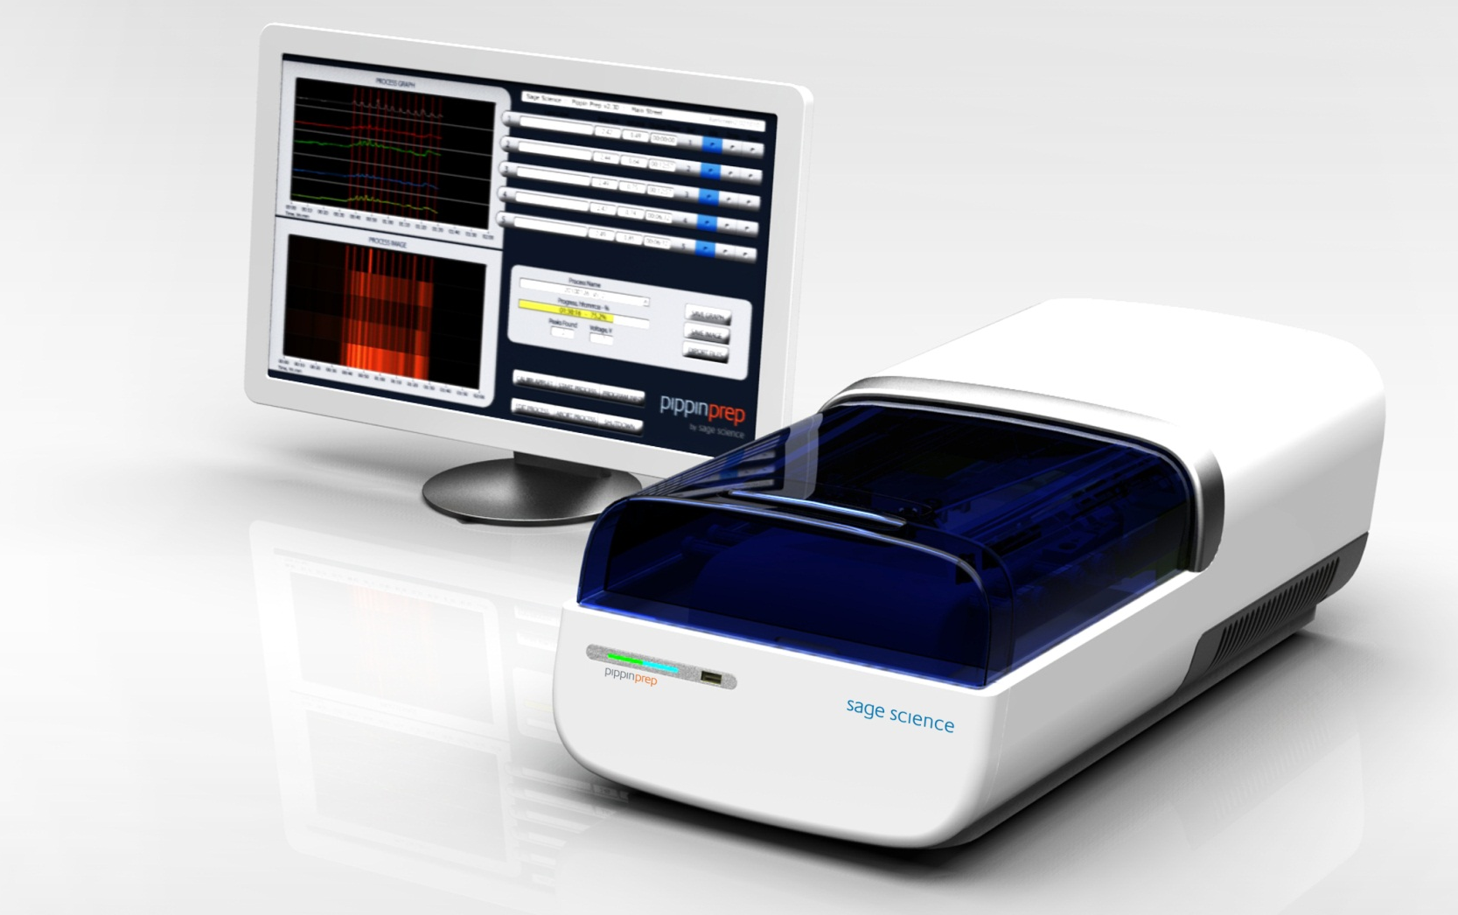
The Blue Pippin Prep System
Automated Preparative Gel Electrophoresis for NGS
Instrument contains:
Electrophoresis pulsed-field gel electrophoresis power supply
Electrode array
Fluorescence detection optics
Single-board PC with control software

Slide 35
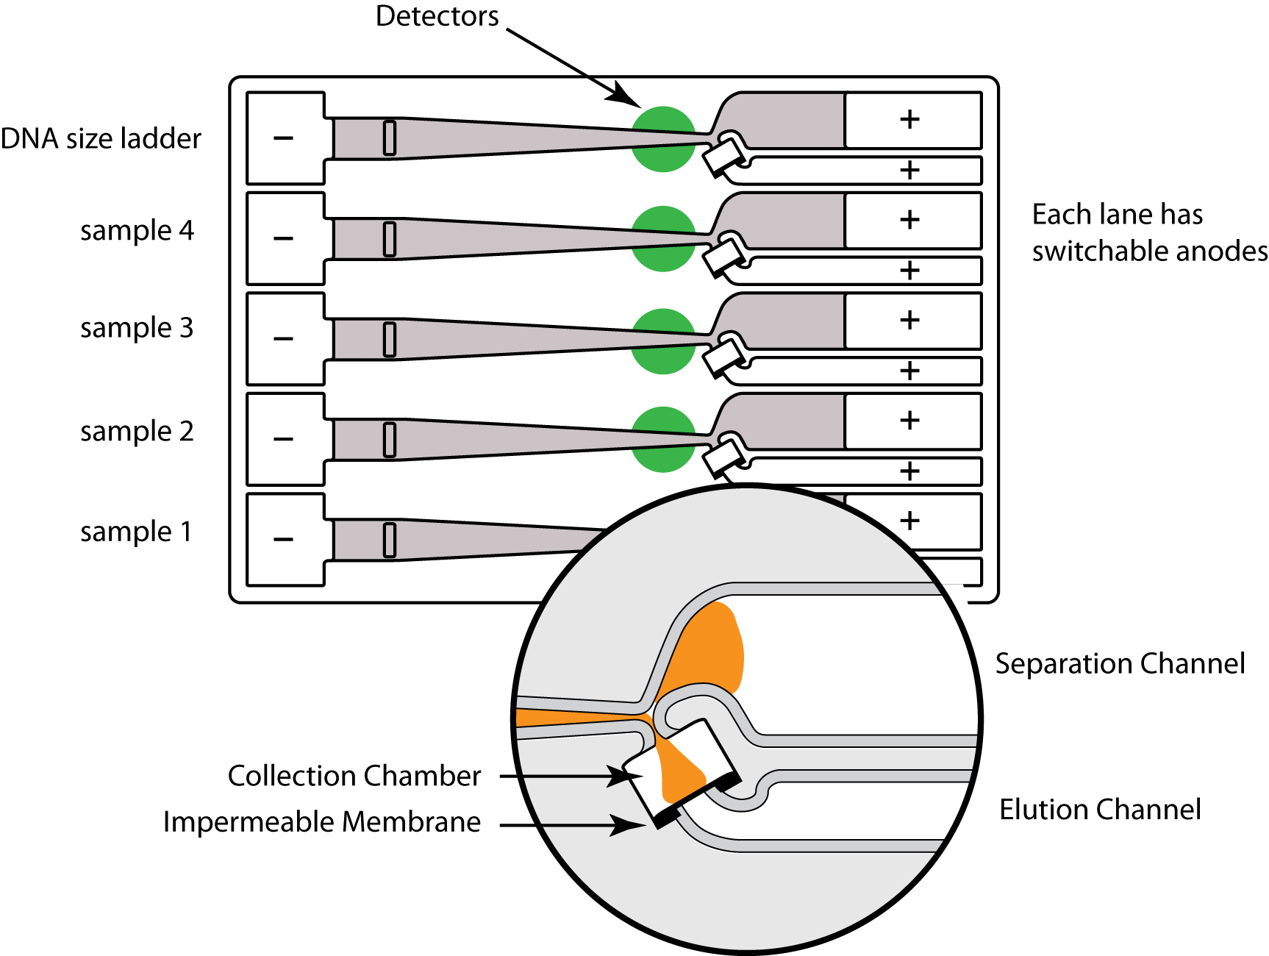
The BluePippin Prep System
Automated Preparative Gel Electrophoresis for NGS
35
Confidential, Sage Science

